Slide 1


poultry diseases
fourth stage
Safety in the Poultry Laboratory.
Diseases and poultry husbandry.
Dr. Isam Azeez
Department of Pathology and Poultry Disease
College of Veterinary Medicine
university of Basrah

Slide 2


Safety in the Poultry Laboratory

Slide 3
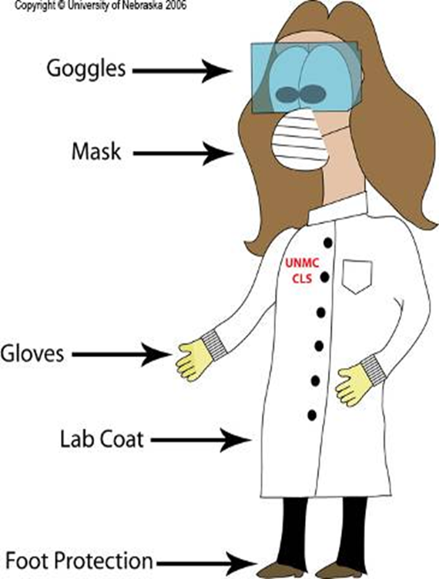
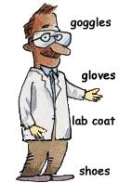
Lab Safety Rules
1-Wear protective clothing .
Gloves are essential.
Lab coats are required.
Safety glasses ( goggles) may
be required to avoid splashes.
Mask
shoes

Slide 4
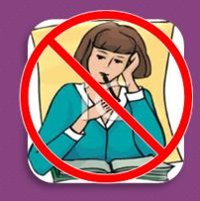
Lab Safety Rules
2- Laboratory persons should not wear accessories
3- while wearing gloves, Avoid touching objects (e.g., pencils, cell phones, door handles).
4- Pencils, labels, or any other materials should never be placed in your mouth.

Slide 5
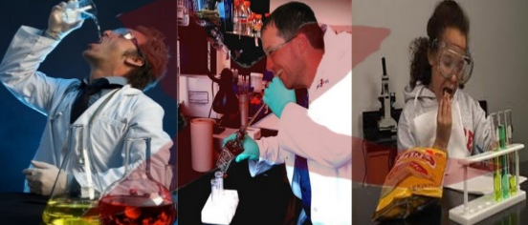
Lab Safety Rules
5. Do not eat food or drink water in the lab, and do not use lab glassware as food or water containers.

Slide 6

Lab Safety Rules
6- Protect your hands safely:
- wash hands after every lab.
- Handle glassware, sharp tools, and heated containers carefully

Slide 7
Lab Safety Rules
7- Keep nonessential books and clothing far away from your work area.
8- Wipe the bench tops down with disinfectant both before you begin your work and after you have completed your work.

Slide 8
Transport of Infectious Material
Great care must be taken when preparing and packing diagnostic specimens for transport to ensure that there is no breakage of containers or leakage of contents that could put at risk postal workers, couriers, or staff at the receiving laboratory.
applicable local, national and international regulations for the transportation of dangerous goods

Slide 9
Storage of Pathogens
The storage of live pathogens requires appropriate containment and security to avoid risks due to breakage or unauthorized use of material.
Storage facilities should be appropriately labeled to indicate the nature of the pathogens (e.g., their group) and the person(s) responsible for them.
Special care must be taken when opening glass vials of freeze-dried pathogens.

Slide 10
Sources of infection
1- Human: One of the most significant potential causes of introducing the disease is that footwear is most frequently suspected as the means of transporting the disease, as well as hands and clothing.
2- Visitors: Disease outbreaks in the community have been known to follow the path of a careless visitor.
3- Carriers : Even seemingly harmless carriers, such as birds, can pose a significant risk. They may have recovered from a clinical infection but still retain the infectious agent in some parts of the body, making them potential sources of disease. This underscores the need for awareness and preparedness.
4- Multiple ages: If the various ages are closely associated, the disease agents are passed by various means, including direct contact.

Slide 11
5—Mixing species of poultry: One species that is naturally very resistant to a disease may act as a carrier of that disease for another species that is very susceptible.
6—Other sources: including egg–borne diseases (diseases that are transmitted from the infected dam to the newly hatched), Equipment (diseases and parasites can be carried on equipment), Rats (contaminated feed and litter), wild birds (capable of carrying a variety of diseases and parasites), insects (act as transmitters of diseases), and feed (feed contains infectious agents ).

Slide 12
Poultry Diseases
* Disease results when normal body functions are impaired, and the degree of impairment determines the severity of the disease.
* Disease may occur due to a deficiency of vital nutrients or the ingestion of toxic substances, or it may be the consequence of harmful infections or parasitic agents.

Slide 13
Infectious
1-Virus: Newcastle Disease, Avian Encephalomyelitis, Fowl Pox, Marek's Disease, Infectious Bronchitis, Infectious Laryngotracheitis, Gumboro Disease (Infectious Bursal Disease), Duck Virus Hepatitis
2- Mycoplasma: Chronic Respiratory Disease
3-Bacteria: Fowl Cholera, Salmonellosis, Pullorum, Fowl Typhoid, Infectious Sinusitis, Colibacillosis

Slide 14
4-Parasites
A-Ectoparasites: lice, mites, ticks
B-Endoparasites: nematodes, Histomoniasis, Haemoparasites, round worms, hair worms, Avian Malaria
5-Protozoa: Coccidiosis, Blackhead
6-Fungus : Aspergillosis: A. flavis (toxins), A. fumigatus (airsaculitis)
Non-Infectious
1-Deficiencies: rickets, curled toe paralysis, encephalomalacia
2-Toxicities: salt poisoning, food poisoning (Botulism Clostridium botulinum and C. perfringens), poisonous plants

Slide 15
poultry husbandry.
What Is Poultry Farming?
In poultry farming, rearing and management of fowls are done for two purposes-
Production of the eggs.
Production of meat.

Slide 16
Farm Management
Poultry farming involves both egg layers and broilers. The housing, feeding, and growing conditions for broilers and egg layers are different. Good management practices are required for high yields.

Slide 17
Shelter
Poultry birds need to be maintained strictly and hygienically with proper housing. A good, clean environment with proper ventilation should be provided. The farm should be pest-free and disease-free. Layers require regular temperature.

Slide 18
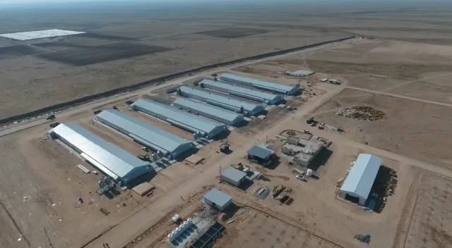

Slide 19
